Slide 1
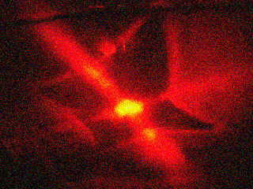
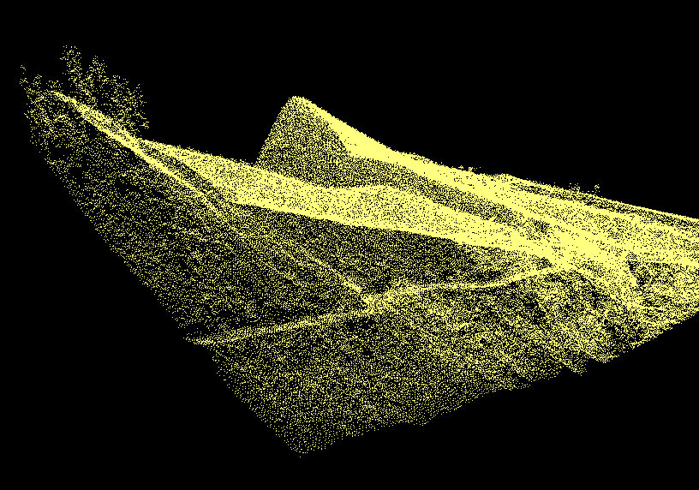
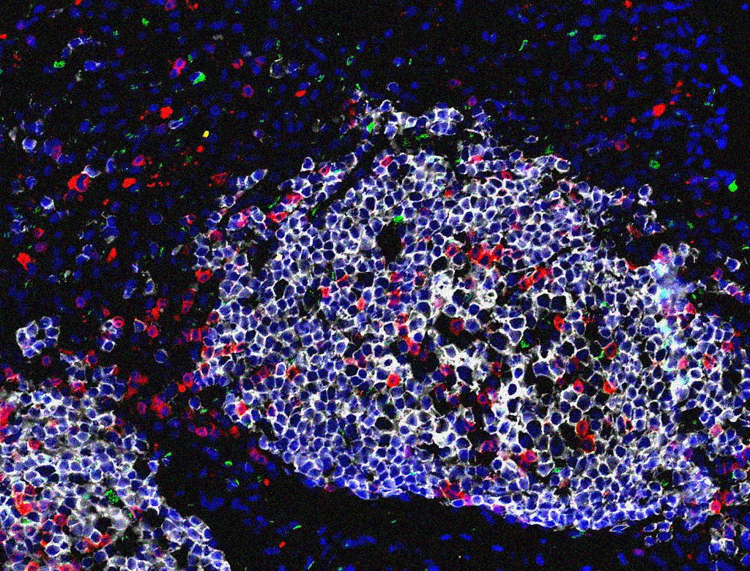
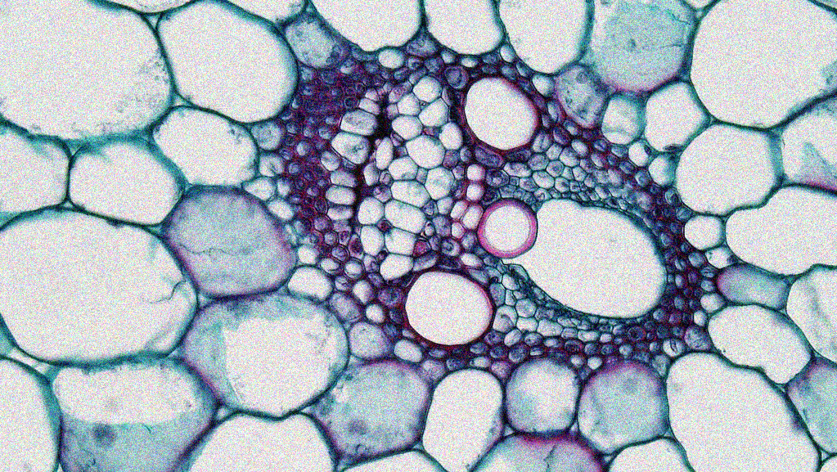
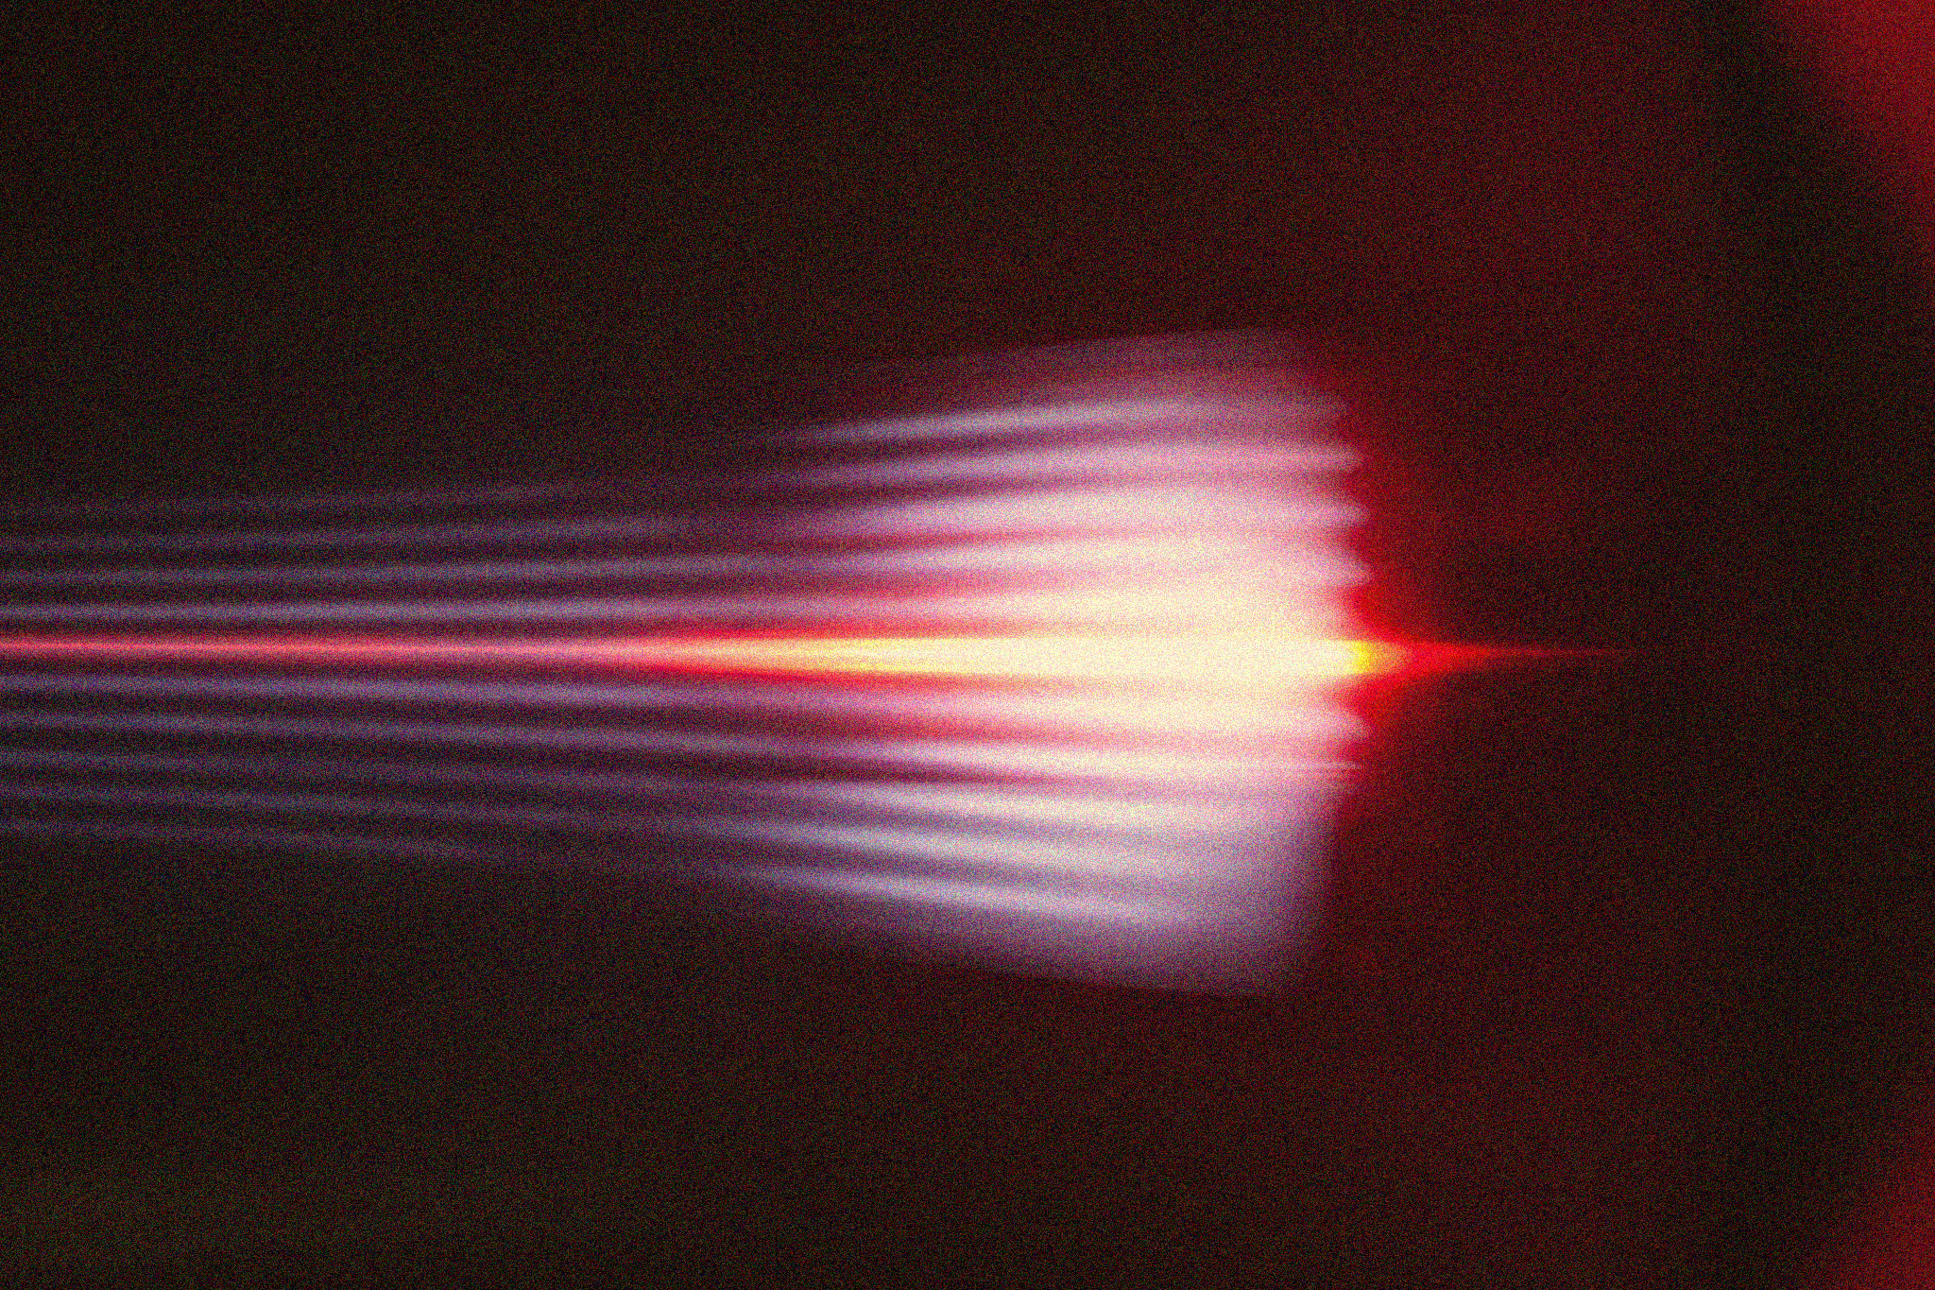
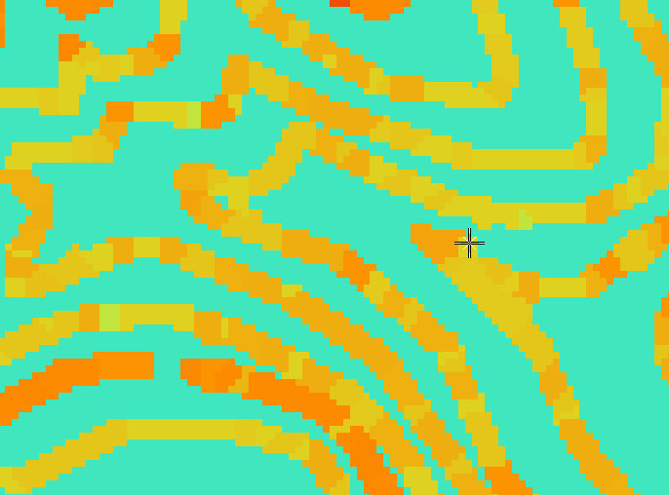
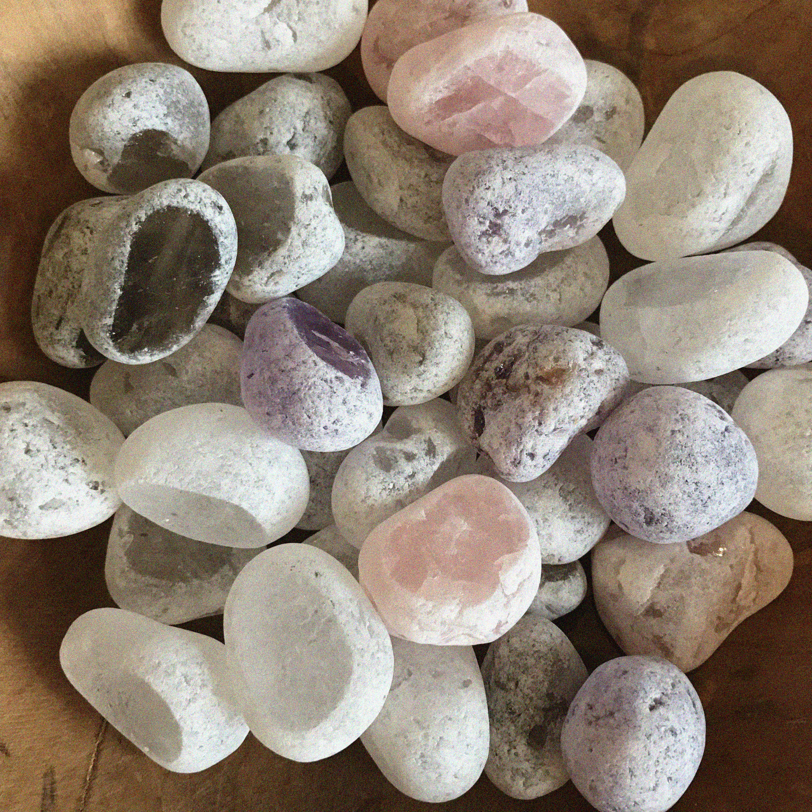
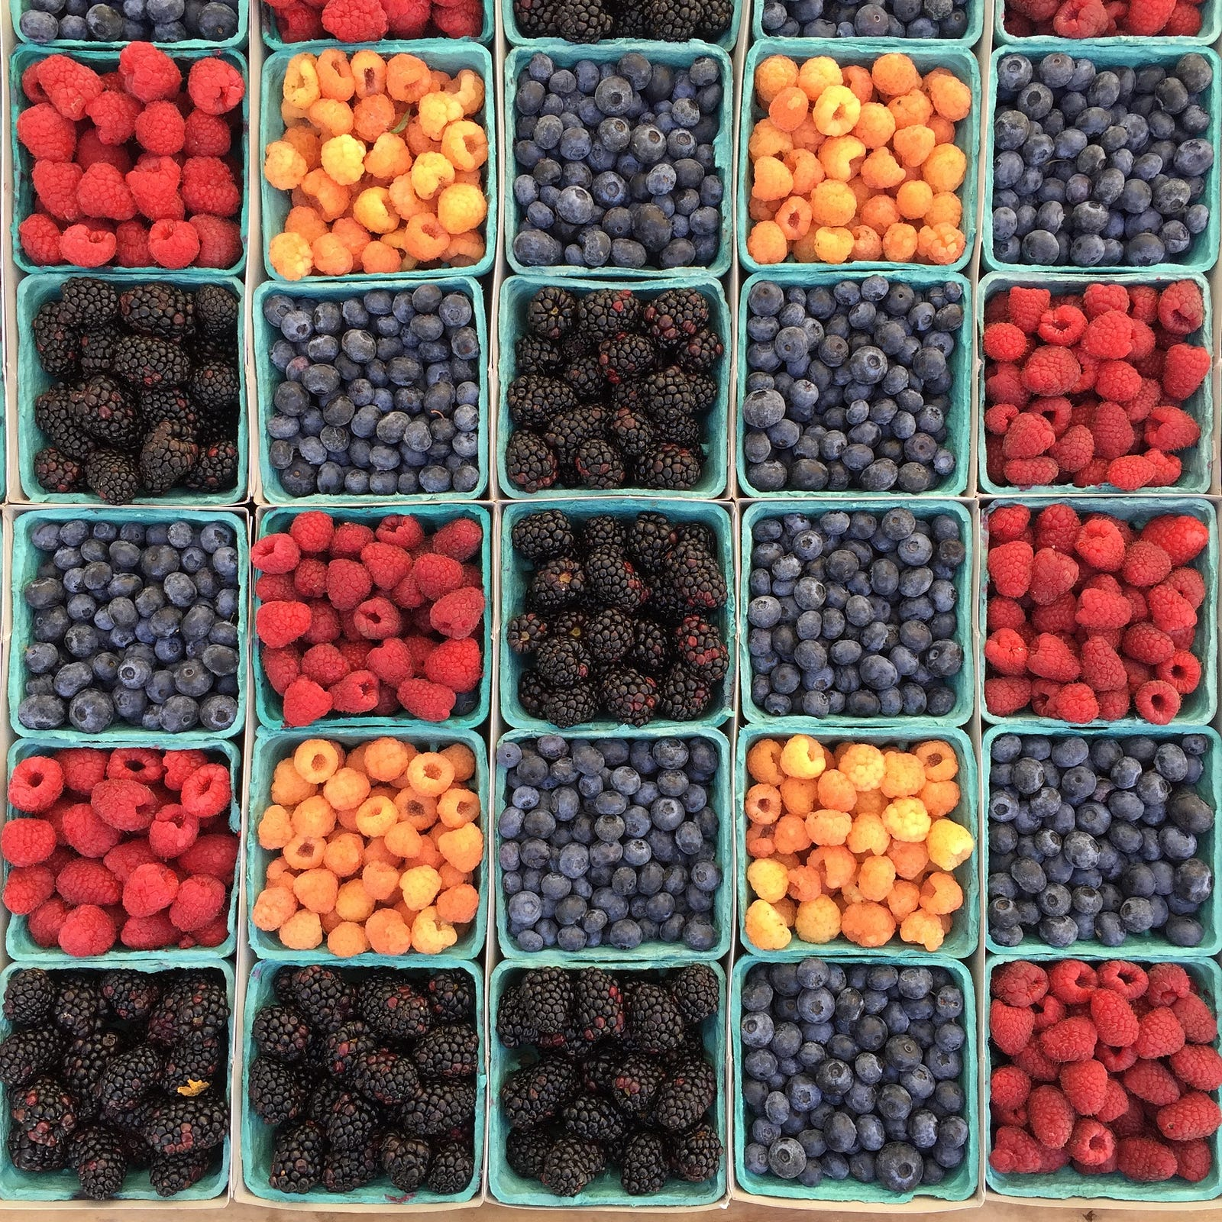

APP PHYSICS 157
COMPUTATIONAL ANALYSIS AND MODELLING
BLOB ANALYSIS
IMAGE AND VIDEO PROCESSING – MODULE 1
NINO PHILIP RAMONES | GITHUB
2020 – 05616
JULY 3, 2023
This Photo by Unknown Author is licensed under CC BY-NC-ND

Slide 2
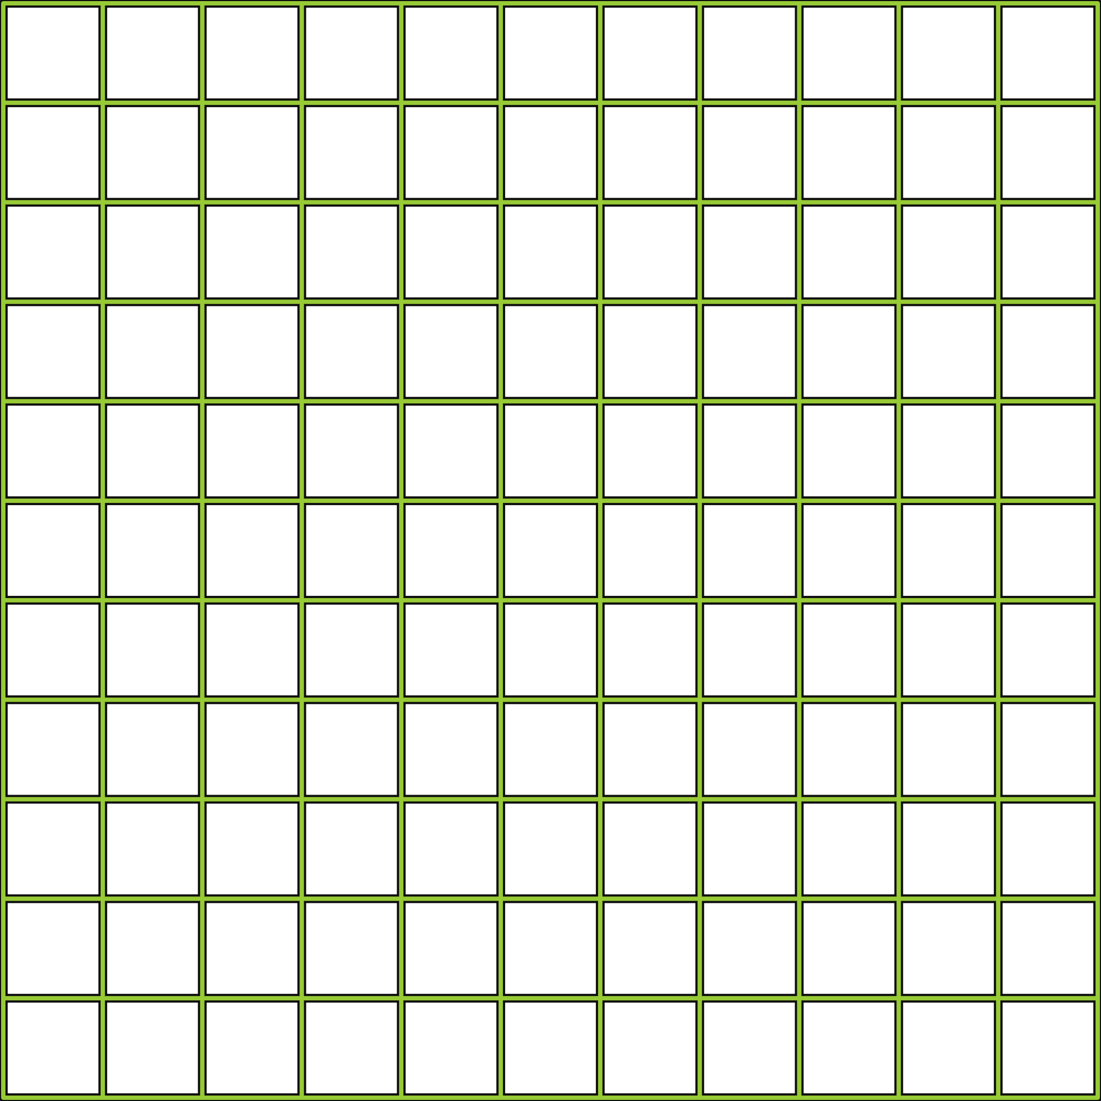
APP PHYSICS 157
MORPHOLOGICAL OPERATIONS
OBJECTIVES
Extract features such as eccentricity and area of cells and blobs from segmented images through thresholding and morphological cleaning
Perform basic statistical analysis to visualize the distribution of the extracted features of the blob samples
KEY TAKEAWAYS
Feature extraction from labelled blobs can be done using regionprops
Analyzing cells through its features can be useful in real world applications such as in medicine and health science as cells can be differentiated and characterized from each other through its size, shape, and other defining features that can be drawn
SOME PITFALLS
Lack of actual measurement against the number of pixels for example hindered the comparison of the mean size of the cells through regionprops
Histogram analysis of the features can be quite inaccurate due to the lack of reference on the actual measurement

Slide 3
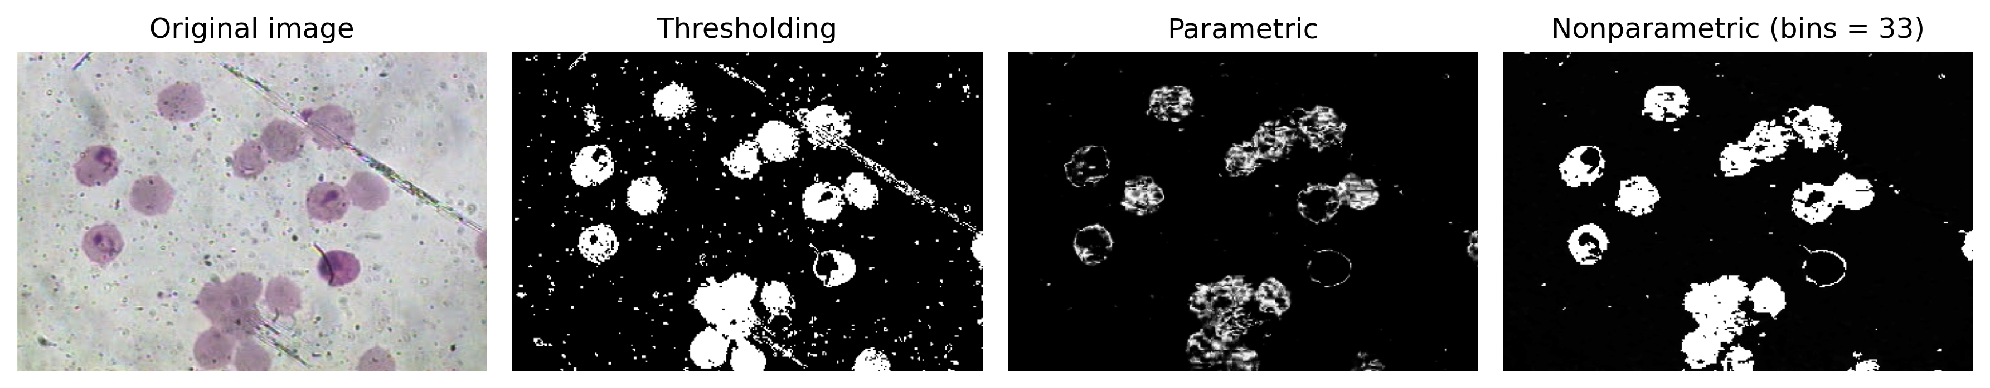
APP PHYSICS 157
MORPHOLOGICAL OPERATIONS
IMAGE SEGMENTATION
Figure 1. Segmentation algorithms employed to the colored microscopic image of malaria cells. The thresholding retained most of the cell shape and visual information.
This activity tends to integrate all the concepts that we have learned so far in extracting the features of such objects contained in an image. Using different segmentation algorithms, the thresholding yielded much of the visual information needed for analysis compared to the parametric and nonparametric segmentation. This were then used for further processing using regionprops. We can use the concept of morphological cleaning to further enhance our segment image!

Slide 4
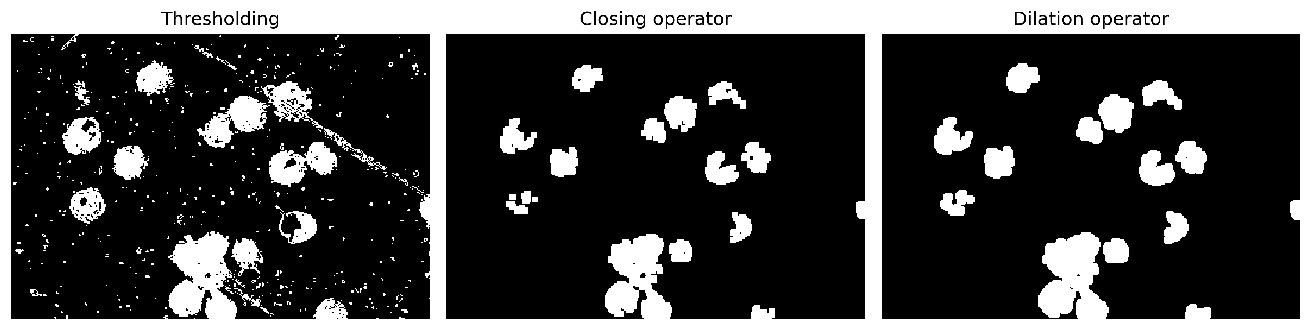
APP PHYSICS 157
MORPHOLOGICAL OPERATIONS
MORPHOLOGICAL CLEANING
Figure 2. Morphological operation performed on the thresholding image. A series of closing and dilation operators were performed using the skimage.morphology library in Python.
Upon the application of the morphological cleaning, the unwanted white dots were removed however the visual information such as the cell shape and size were altered upon further processing. The dilation operator was applied right after the closing operator to enlose further the small voids within the cells. A sample image of the red blood cells were then considered for trial to see how regionprops extracts the data we want for analysis --- area, eccentricity, and perimeter.

Slide 5
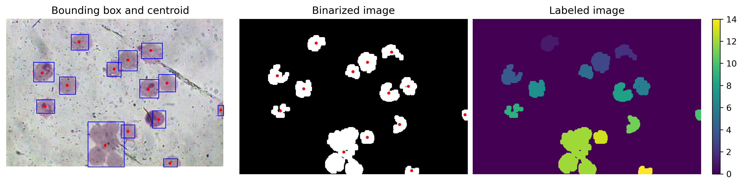
APP PHYSICS 157
MORPHOLOGICAL OPERATIONS
FEATURE EXTRACTION SAMPLE
Figure 3. Skimage regionprops generated a bounding box enclosing the blobs and calculated its centroids. The watershed algorithm was used to label the image and around 14 cells were detected.
Using skimage.regionprops, the bounding box that encloses the blobs or malaria cells were plotted and the corresponding centroids of the cells were calculated across the coordinate space given by the size of the image. Around 14 cells were detected from the labelled image shown above corresponding to the number of centroids computed. On the succeeding samples, other interesting features were extracted to see the distribution of mean sizes and shapes of the cells.

Slide 6
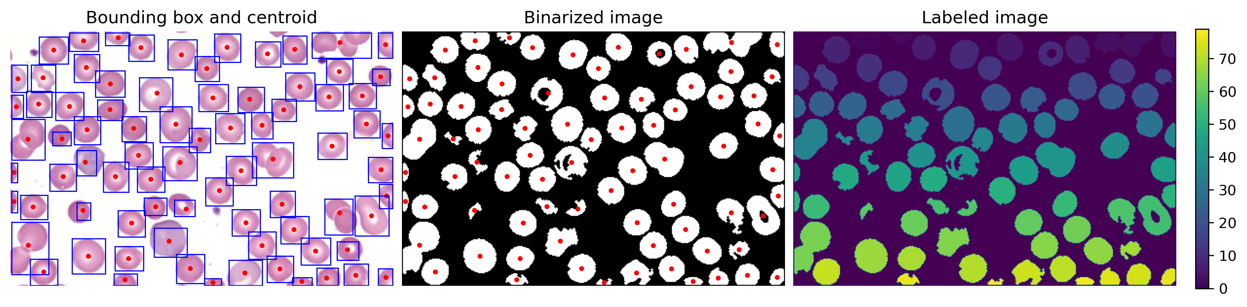
APP PHYSICS 157
MORPHOLOGICAL OPERATIONS
RED BLOOD CELLS
Figure 4. Regionprops of the red blood cell samples. Around 80 cells were detected which were filtered further to select and label cells whose area meets the set threshold for detection.
On the sample for red blood cells, regionprops initially returned an inaccurate number of labelled blobs due to the amount of irregularly-shaped cells on the binarized image of the sample through nonparametric segmentation. Employing a series of morphological cleaning on the segmented image, the blobs were labelled through bounding boxes and centroids. The problem on labelling the blobs were circumvented by setting a threshold area of the cells wherein blob areas above a certain value will be labelled, otherwise, it will be discarded.

Slide 7
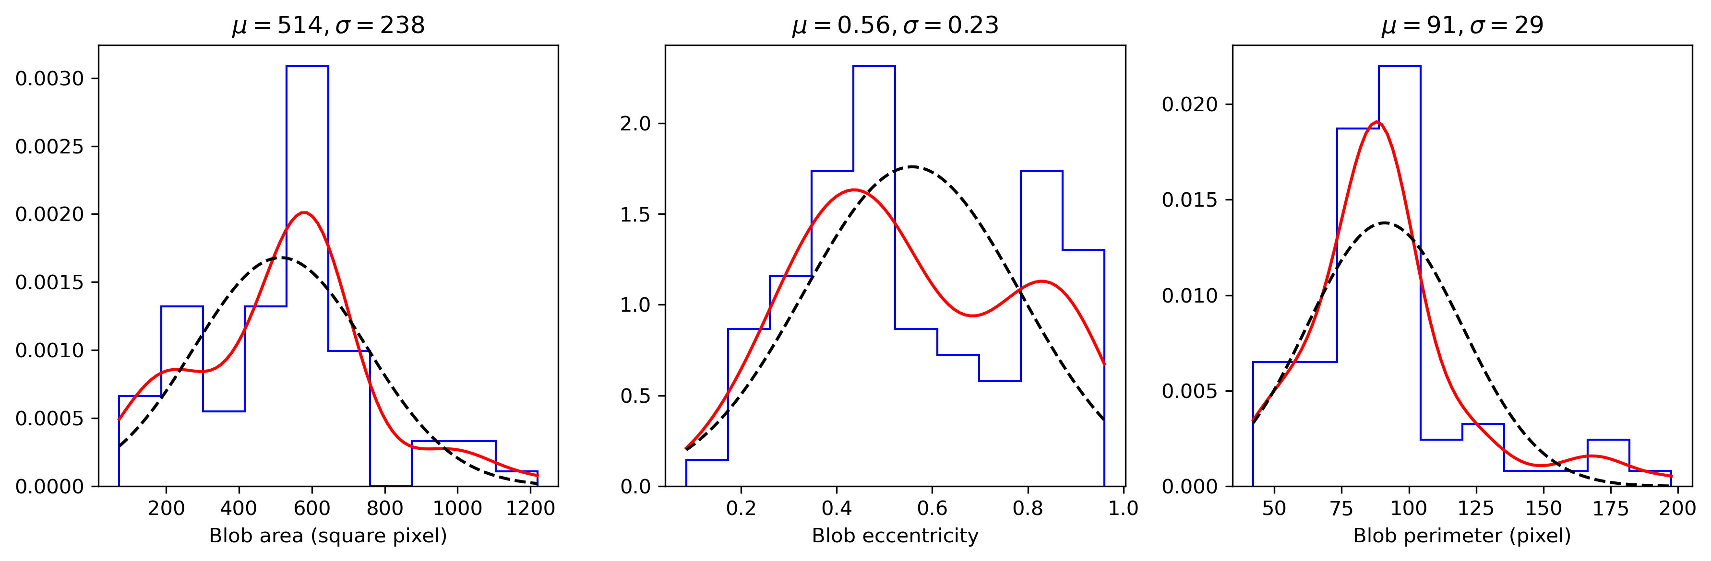
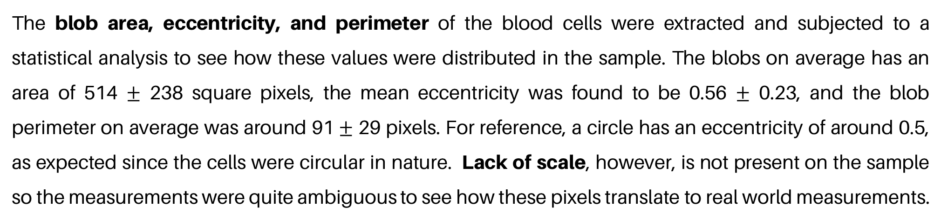
APP PHYSICS 157
MORPHOLOGICAL OPERATIONS
HISTOGRAM ANALYSIS
Figure 5. Histogram analysis performed on the extracted features of the red blood cells. The blue line represents the histogram of the values, dotted black represents the normal distribution of the data, and the red line corresponds to the kernel density estimate.
The blob area, eccentricity, and perimeter of the blood cells were extracted and subjected to a statistical analysis to see how these values were distributed in the sample. The blobs on average has an area of 514 $±$ 238 square pixels, the mean eccentricity was found to be 0.56 $±$ 0.23, and the blob perimeter on average was around 91 $±$ 29 pixels. For reference, a circle has an eccentricity of around 0.5, as expected since the cells were circular in nature. Lack of scale, however, is not present on the sample so the measurements were quite ambiguous to see how these pixels translate to real world measurements.

Slide 8
APP PHYSICS 157
MORPHOLOGICAL OPERATIONS
REFLECTION
I was able to apply the segmentation algorithms and morphological cleaning on the sample images and compare their effect on the blob detection algorithms through regionprops. Statistical analysis were carried out to see distribution of the data and estimated value for the extracted features of the cells such as the area, eccentricity, and perimeter. Scaling should be present to carry out a much detailed comparison on the sizes of the cells. The blob analysis were successfully executed as I was able to employ the algorithm and concepts from the previous activities. Overall, I would give myself a score of 110/100 !
REFERENCES | GITHUB
M. Soriano, Applied Physics 157 – Feature extraction from labelled blobs, 2023.
Measure region properties — skimage 0.21.0 documentation (scikit-image.org)
Label image regions — skimage 0.21.0 documentation (scikit-image.org)

